Slide 1
Conditional Operator
Submitted by
Vignesh km

Slide 2
Conditional Operator in C
The conditional operator is also known as a ternary operator.
The conditional statements are the decision-making statements which depends upon the output of the expression.
It is represented by two symbols, i.e., '?' and ':'.

Slide 3
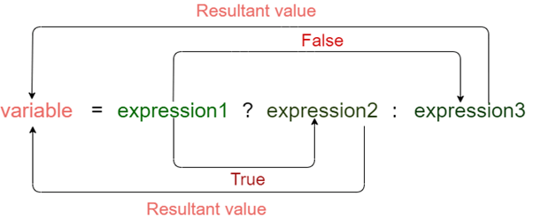
Syntax of a conditional operator
Expression1? expression2: expression3;

Slide 4
Meaning of the above syntax.
In the above syntax, the expression1 is a Boolean condition that can be either true or false value.
If the expression1 results into a true value, then the expression2 will execute.
The expression2 is said to be true only when it returns a non-zero value.
If the expression1 returns false value then the expression3 will execute.
The expression3 is said to be false only when it returns zero value.

Slide 5
Let's understand the ternary or conditional operator through an example.
#include <stdio.h>
int main()
{
int age; // variable declaration
printf("Enter your age");
scanf("%d",&age); // taking user input for age variable
(age>=18)? (printf("eligible for voting")) : (printf("not eligible for voting")); // conditional operator
return 0;
}

Slide 6
A conditional operator is a single programming statement, while the 'if-else' statement is a programming block in which statements come under the parenthesis.
A conditional operator can also be used for assigning a value to the variable, whereas the 'if-else' statement cannot be used for the assignment purpose.
It is not useful for executing the statements when the statements are multiple, whereas the 'if-else' statement proves more suitable when executing multiple statements.
The nested ternary operator is more complex and cannot be easily debugged, while the nested 'if-else' statement is easy to read and maintain.

